Slide 1
TACTILE GRAPHICS
ON THE FLY
Magic Tricks and Quick TGs for Busy TVIs and O&Ms

Slide 2
ViRGINIA AER
Presented by
Lucia Hasty, MA
Braille Authority of North America
Tactile Graphics Committee Chair
March 3, 2010

Slide 3
Treasure your special skills
(Here comes sermon number 1!)
We try to “do it all”
We overlook others who could help
We lose sight of what is unique about our training and skills
Prioritizing tasks is a constant challenge for us.
TGs for students- PERFECT recruitment tool!

Slide 4
Get everyone invested
Be an award-winning salesman– Empower
others to produce graphics on the spot
Experience: Teach others in the student’s daily contacts to produce graphics for and with your student
Equipment: Make sure whatever is needed is readily available, stock is kept up to date.
Expectations: Student needs to read and write information in context- “easy” to include him.

Slide 5
budget your time well
Be judicious- carefully decide (with the classroom teacher) which graphics are really necessary. Also ask the student- you would be surprised how often the student understands the concept and just needs the specific data in that graphic.
Use the Decision Tree to help determine need
Can someone else produce or provide the graphic?
Notes:
Math concepts- j needs to know measurement of 1 side of cube

Slide 6
Utilize existing resources
Braille Transcriber’s Kit: Mathematics
Braille Transcriber’s Kit: Countries and Continents, States
World Maps or other atlas with sticky labels
Models, as often as possible
Geometry Tactile Graphics
Human Anatomy Atlas
Tangible Graphs
Sense of Science series
Wheatley Picture Maker

Slide 7
Repurpose items you have
100s boards and braille Scrabble boards make great bases for crossword puzzles, templates for teaching long division, drawing chemical bonds, and other spatially arranged materials
Left-over velcro from APH products e.g. classroom calendar kit for textures

Slide 8
Make it Sticky
Look for self-adhesive items for textures to create areas, lines, point symbols.
Xyron products can make anything sticky
Develop supply of textures ready to use, organized for quick retreval

Slide 9
Plan ahead
Review student’s curriculum and know what content will need graphics
Develop master outline or base graphic for units/subjects for which your student will need a number of graphics.
You may need to pre-teach some graphics.

Slide 10
Other Resources
APH Image Library
http://www.aph.org/tgil/index.html
ViewPlus for Tiger and IVEO graphics
http://downloads.viewplus.com/examples/2
View International Foundation- former TAEVIS graphics library
http://viewinternational.org/diagrams.htm

Slide 11
More resources
Textbook publisher websites- many free graphics outlines for all subjects
Google “outline map Virginia” and look at the few resources available
Wgbh.org- Guidelines for descriptions of STEM graphics- National Center for Accessible Media
http://ncam.wgbh.org/experience_learn/
educational_media/stemdx

Slide 12
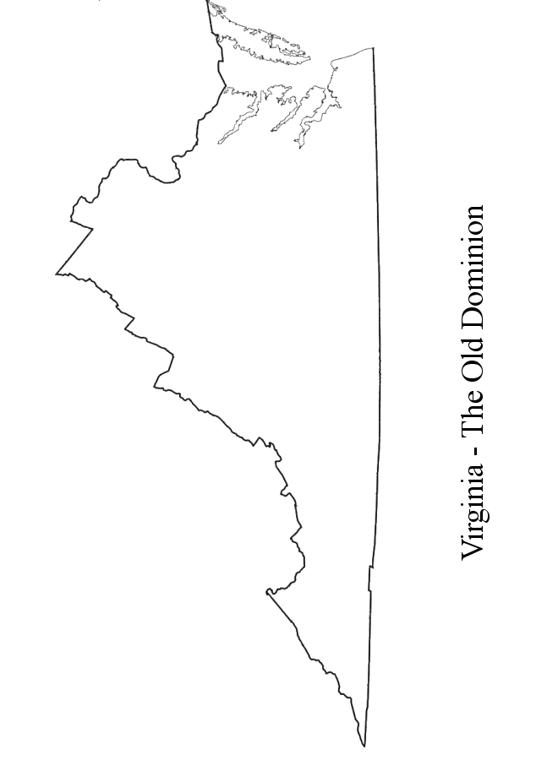

Slide 13
Avoid only providing descriptions of graphics as the default rather than the student having the opportunity to interpret a tactile graphic.

Slide 14
www.tactilegraphics.org

